Slide 1
Designing Out Crime
Carin Andrews
Kent Police DOCO Team
Notes:
Mention team of 13 reduced to 2

Slide 2
Perimeter Security
An attack either by an individual or state sponsored actor could lead to:
Downtime
Damage and the cost of replacement
Clients lose confidence in you service
People could be harmed

Slide 3
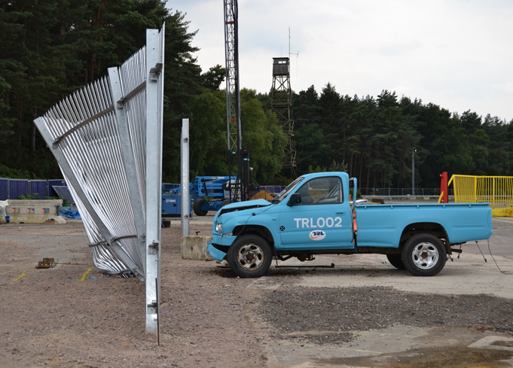
Risk Assessment
Before looking at security products you need to carry out a risk assessment to understand the threats you need to mitigate for.
Physical Attack
Hostile Vehicle Mitigation

Slide 4
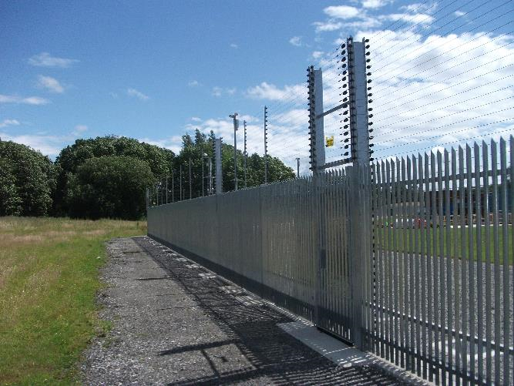
Mitigating the risk
Fencing and entrance security is often the first layer of protection to deter and deny unauthorised entry making it extremely important
The main aim of a perimeter fence is to demarcate the boundary. However the value or danger of what is inside and the threat that this poses may mean the site requires a third party accredited fence.

Slide 5
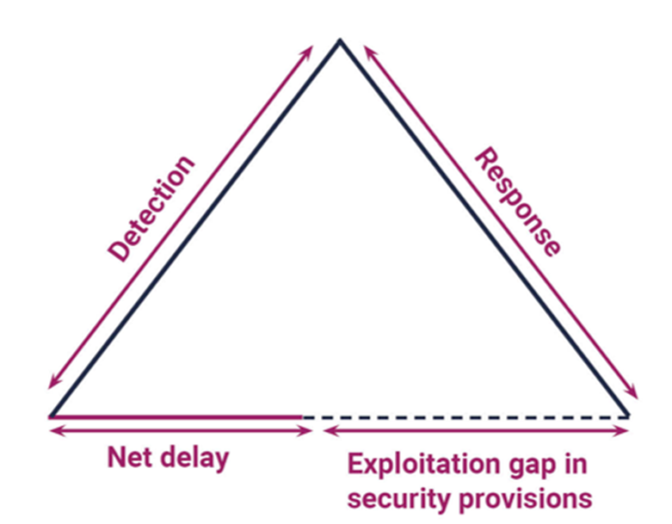
The Purpose of Security

Slide 6
The Purpose of Security
The purpose of security measures is to detect and delay an attack in order for security or the police to respond and stop the act. The first diagram shows that if the delay is not equal to or greater than the detection and response time then there is a gap which can be exploited.
This highlights the need to properly consider and evaluate how much time delay is necessary. The difference between the delay the security products create, and the time it takes for the attacker to be detected, plus for the back up to respond, is considered open time for the attacker to exploit the gap in security. The delay provided by physical barriers is critical to the protection of the assets.

Slide 7
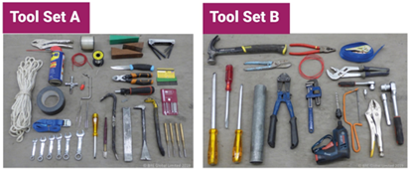
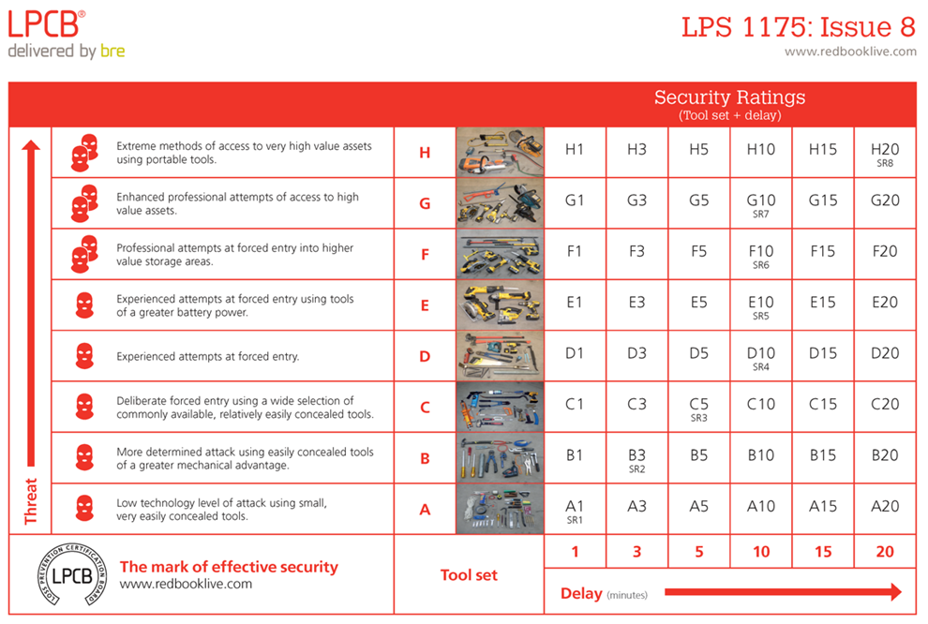
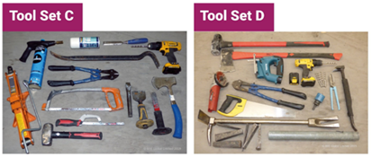
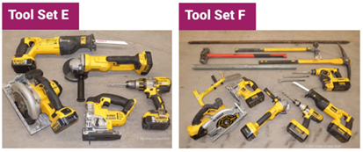
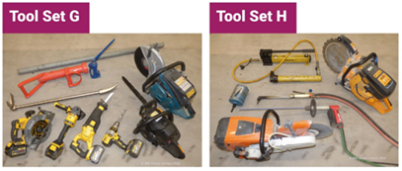
LPS 1175 Toolkit and Gradings

Slide 8
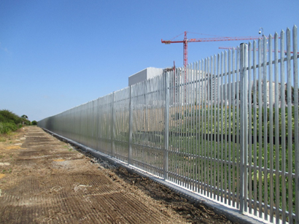
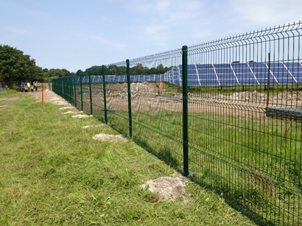
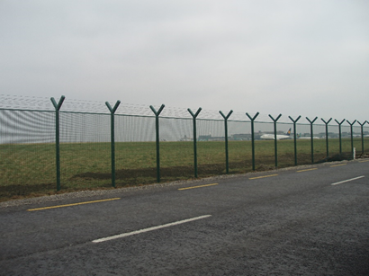
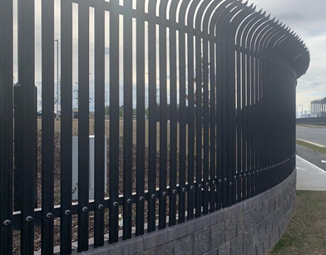
Appearance
An intimidating fence can make a big difference to breaking and entering attempts
A more aesthetically pleasing fence may not deter people
Palisade's intimidating appearance mixed and pointed pales provides a strong deterrent
Mesh looks more discrete and may be accepted by planners more readily but by looking less intimidating, it is also less likely to deter an attack

Slide 9
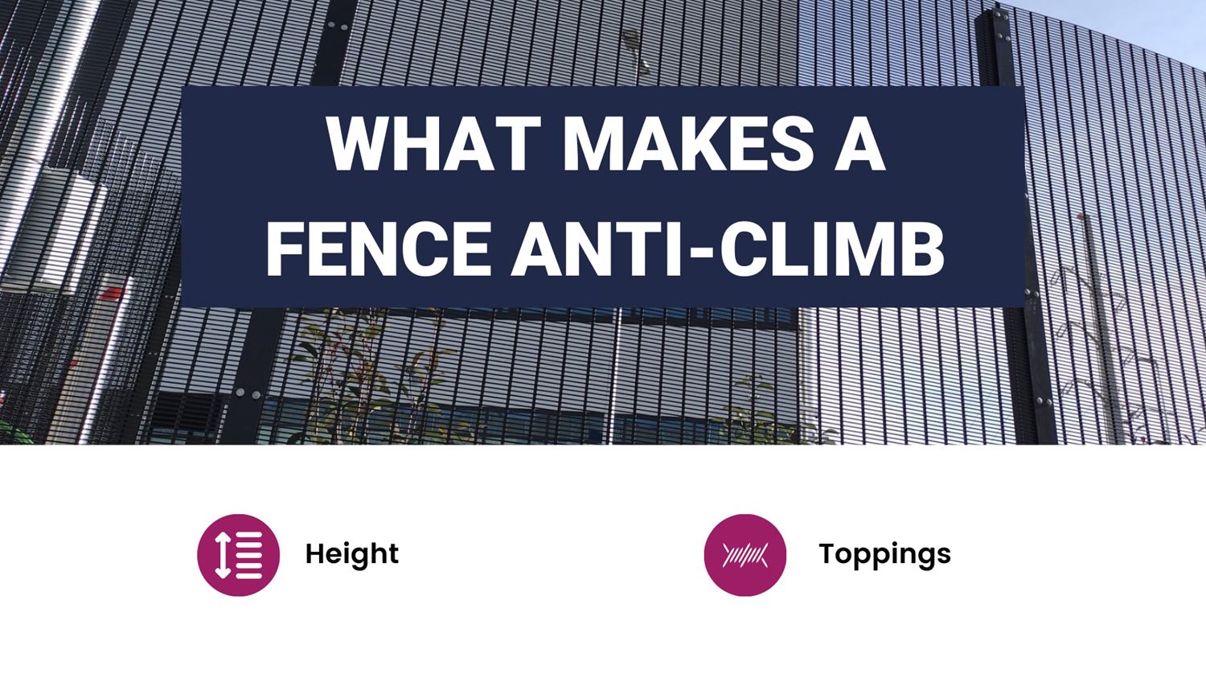
Types of Fence
Planning Appeals – e.g. App/G2245/W/15/3130787

Slide 10
What makes a fence anti-climb
A fence can have features that make it difficult for a person to climb, but whether they will prevent climbing depends on the attacker’s intent and expertise.
Two key factors that make a fence difficult to climb: the height of the fence and a security topping.
None of the forced entry accreditations actually check whether it’s possible to climb the fence. The only accreditation that refers to height is LPS 1175 which has minimum heights for each tool set.

Slide 11
What makes a fence anti-climb
As with mesh fencing, there is a varying degree of quality in palisade systems on the market. If you are using low quality, untested palisade fencing, the pales are likely to be further apart meaning that someone could use the rail as a foothold.
In addition, simple, easily concealed tools may be used as climbing aids to overcome such fences.
On high security palisade fencing systems, the pales are much closer together, leaving no room to get a foot up. Other than the rail, the pales run vertically so there’s very little for a person to be able to get a foothold on especially on higher fences.
So let’s discuss what actually makes a fence difficult to climb….
Notes:
Refer to KDI book and list 7 attributes

Slide 12
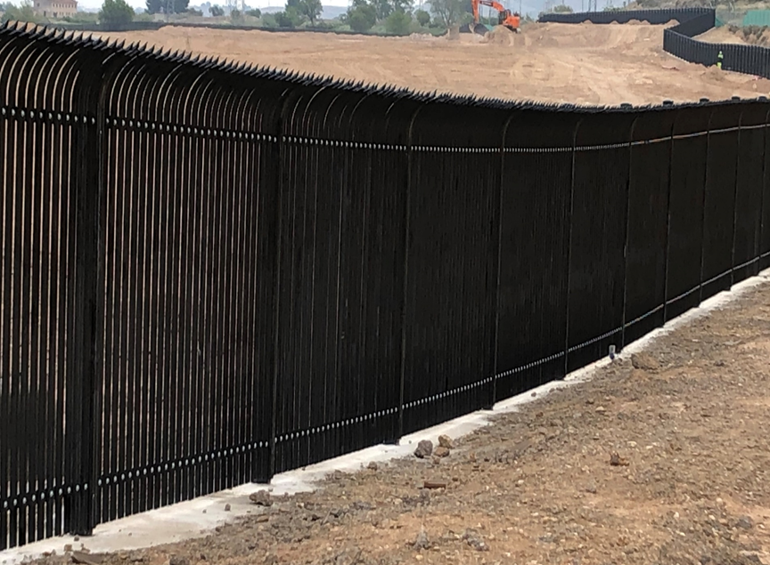
Height
The height of the perimeter is possibly the most obvious factor… Does an intruder really want to be 3 meters in the air while attempting to gain access to a site?
The higher the fence, the longer it will take to scale (even with a ladder) and the longer an intruder will be vulnerable to detection – whether visually or through technology. They’ll also have further to fall.

Slide 13
Height
The combination of the risk of being caught or falling is more likely to deter a novice intruder from scaling a fence. The more skilled/trained attackers will be prepared and probably in a small, organized group and go through the fence rather than over it.
If you are concerned an intruder will use a ladder, consideration may be given to investing in a dual set of fences that form a sterile zone. While the intruder may scale the first layer using a ladder, it can take considerable planning and effort to scale the second – particularly if carrying tools to breach a building facade or other subsequent protective measures.

Slide 14
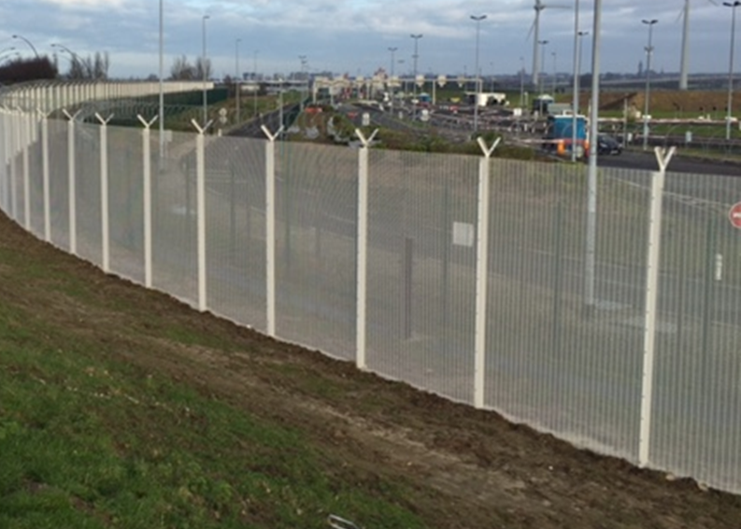
Toppings
Toppings can include:
Barbed wire
Razor wire
Rotating spikes
Anti-climb spinners
Rota spike
Electric pulse fence
Curved Top Pales or Panels
4:2016 for example).

Slide 15
Toppings
Some of these toppings are sharp and spikey, meaning if an intruder was to touch it or attempt to climb over, they could be cut and caught on them. This increases the risk of the intruder being injured thus it is likely to deter them from even attempting. It may not deter the more professional attacker but will slow them down.
These systems are attached in different ways using specially designed post or bolt-on extensions. For example, barb and razor wire is normally fitted using ‘T’ or ‘Y’ extension. ‘T’ extensions mean the wires will be upright, whereas ‘Y’ extensions mean the wires will be curving outwards the front of the fence.

Slide 16
Toppings
When the topping is extending outwards, the depth an intruder would need to get over is extended, making it more difficult to climb over. Therefore, we would always advise ‘Y’ extensions, but certain planning restraints mean Y extensions are not possible and ‘T’ extensions can then be used.
The downside of adding an anti-climb topping onto your system is the cost of the additional material and the cost of the installer adding this to the fence. There are also additional risks for the installation team when attaching something sharp and spikey to the top of the fence, and method statements must be provided to cover this.
Alternatively, rather than adding additional security toppings, fences with the palisade pales curved outwards or the mesh panel curved outwards can be an option. This curving creates an overhang that a person climbing would need to pull themselves over. This makes the system more difficult to climb, especially on palisade as the tops of the pales are spiked.
Planners sometimes frown when Rota Spikes/Razor/Electric toppings are specified as part of the security plan.

